Slide 1

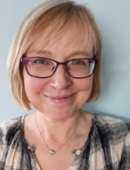
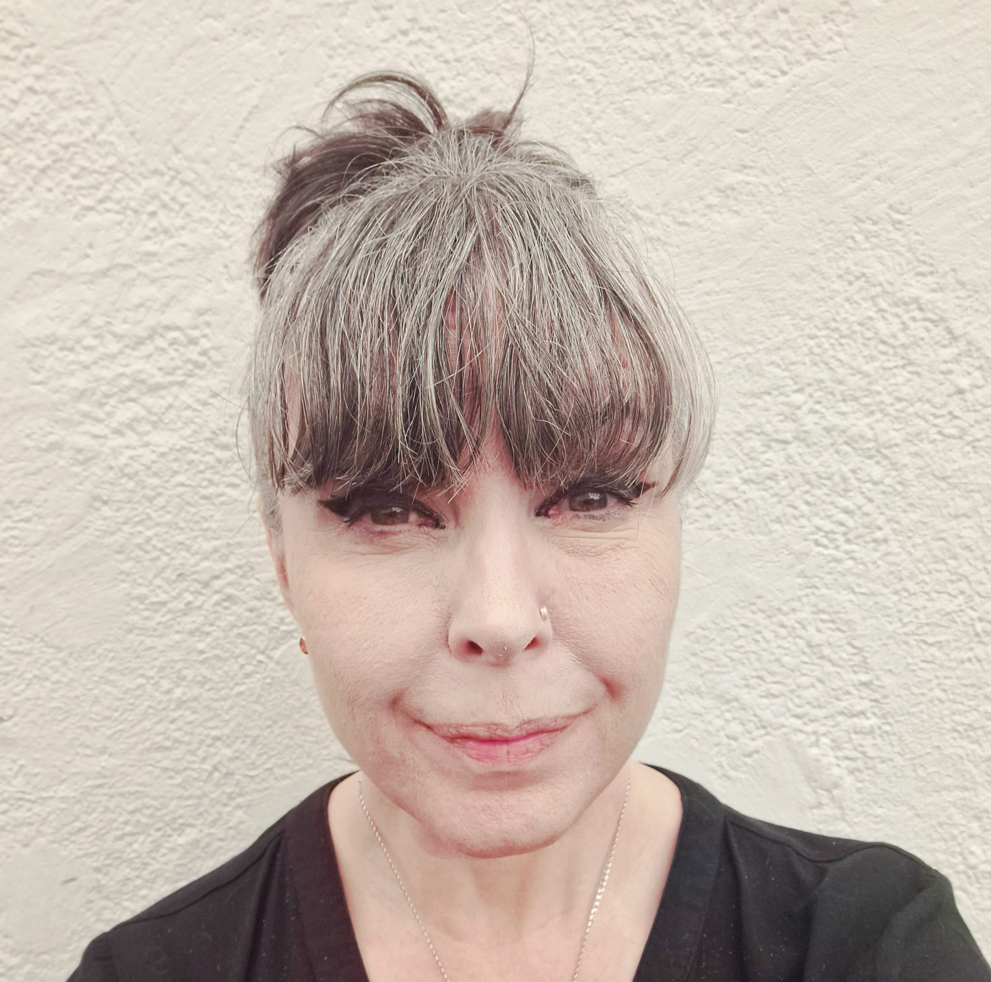
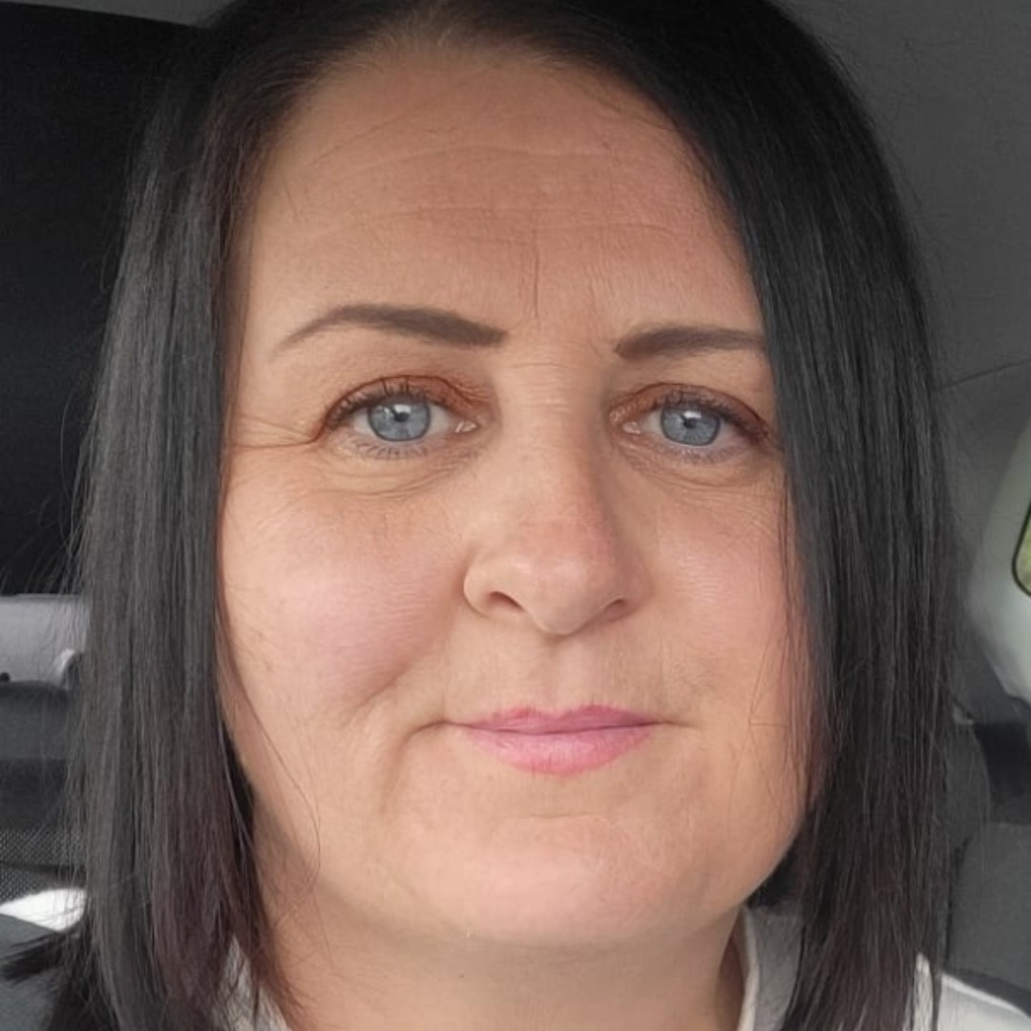
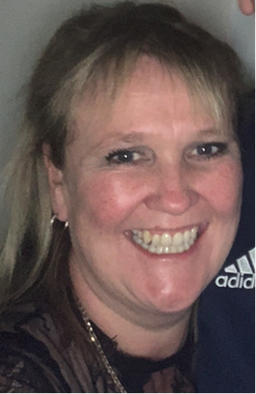
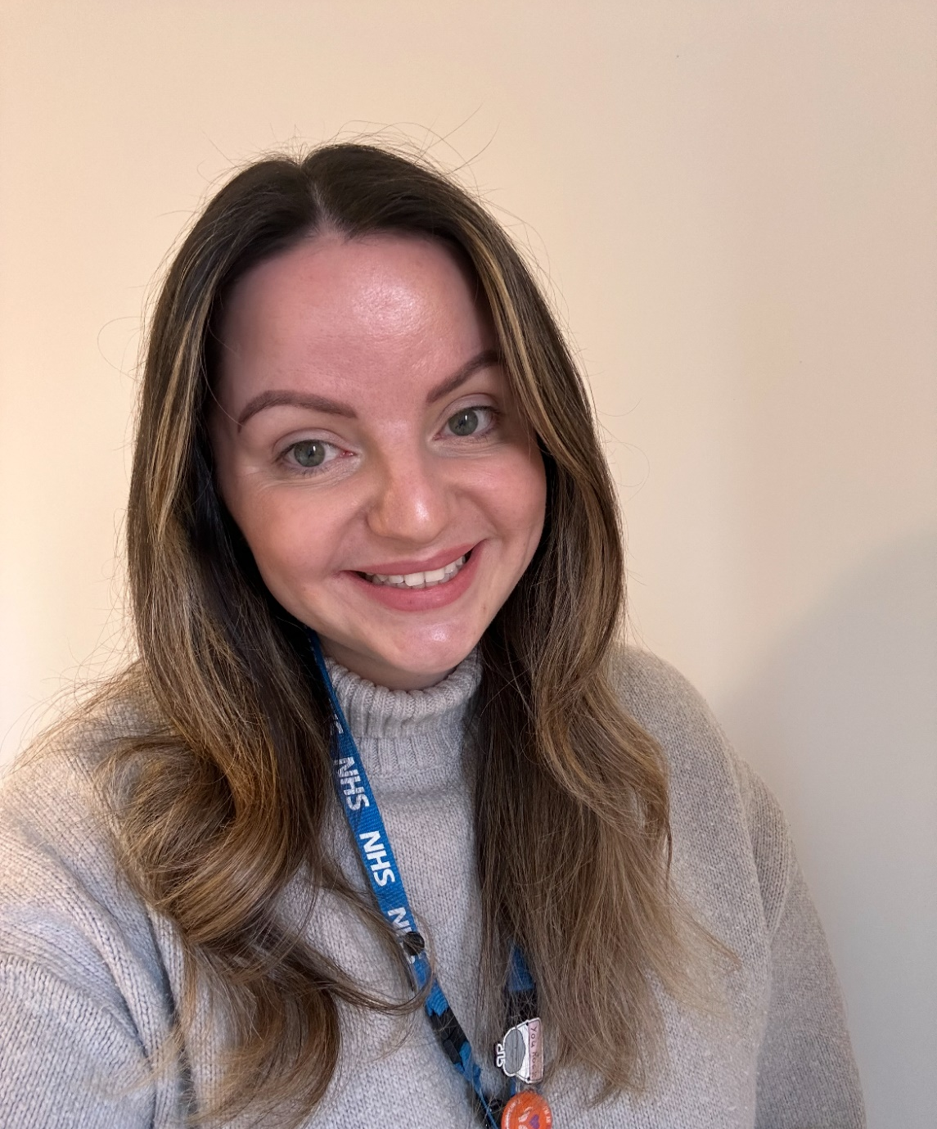

Meet the team
Corby 1
Team
MENTAL HEALTH SUPPORT TEAM (MHST)
Carrie
Jo
Amanda
Kim
Abi

Slide 2

We offer support to children and young people who are struggling with worry, feeling stressed, low or anxious.
We offer individual sessions to children/young people referred into our team, with consent of the parents/carers either at school or at our base, Willowbrook Health Centre.
It can be hard for parents trying to support a child or young person with emotional/behavioural difficulties. We therefore offer parent support if this is more suitable or needed.
We also offer class sessions across the year groups on different topics relating to mental health.
Lastly, we offer signposting to schools and parents to other services that can offer support.
CORBY MENTAL HEALTH SUPPORT TEAM (MHST)

Slide 3

We work closely with the Mental Health Lead in each school and have regular meetings with them.
If you, as a parent/carer have any concerns about your child’s mental health and would like to enquire about support, please contact the school.
We work closely with the Mental Health Lead in each school and have regular meetings with them.
If you, as a parent/carer have any concerns about your child’s mental health and would like to enquire about support, please contact the school.
For further information please use the QR code or go to www.nhft.nhs.uk/mhst
CORBY MENTAL HEALTH SUPPORT TEAM (MHST)

