Slide 1
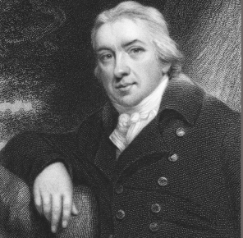
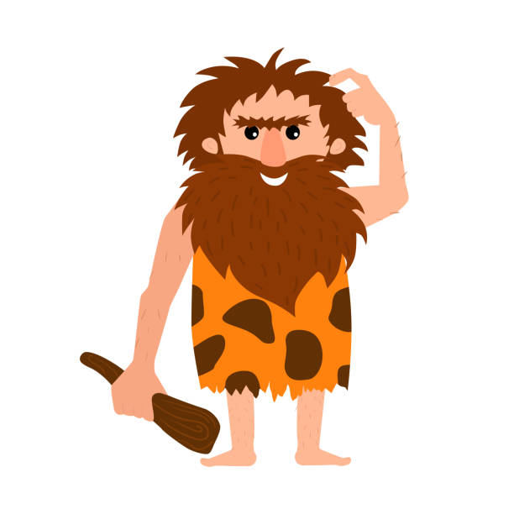
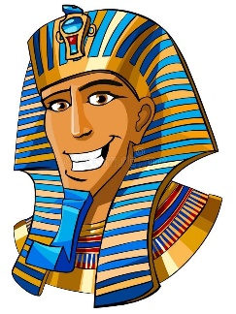
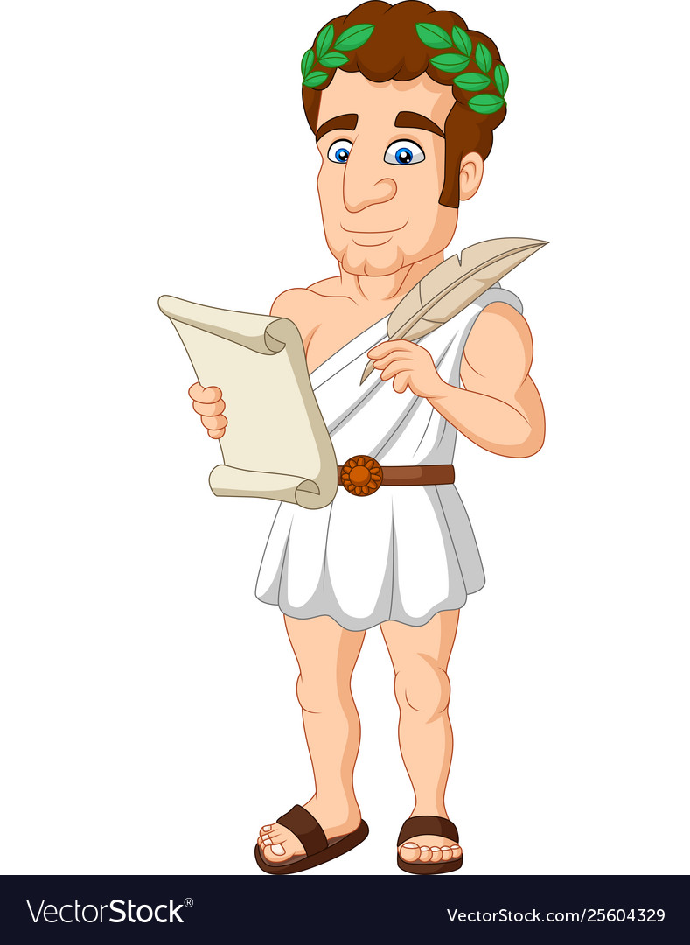
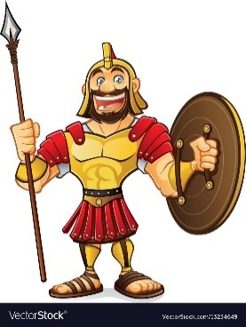
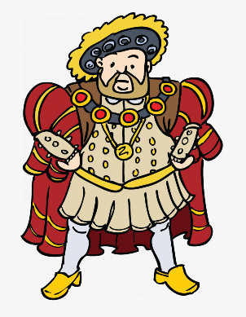
Medicine: Miracle cures or fanciful theories?
Vocabulary
Primary source | An original piece of evidence from a period of history – it was made/ discovered during the time being studied.
Secondary source | Information recounted or described from another’s view – it was made after the time period being studied.
Remedy | A medicine or treatment for disease or injury.
Anatomy | A branch of science concerned with the bodily structure of humans, animals and other living things.
Physician | A person qualified to practice medicine – especially who specialises in diagnosis and medical treatment as distinct from surgery.
Miasma | An unpleasant or unhealthy smell or vapour.
Quarantine | To be placed in isolation in order to prevent the spread of an infectious disease.
Symptoms | A physical or mental feature which is regarded as indicating a condition of disease.
Antiseptics | Preventing the growth of disease- causing microorganisms.
Sterilisation | The process of making something free from bacteria or other living microorganisms.
Edward Jenner
In 1789, Edward Jenner created the first ever vaccine. After studying a deadly disease called ‘Smallpox’ for years, he found that if a person was given a harmless disease called ‘Cowpox’ first then they would be immune from it – saving millions of lives.
Name | Discovery
Florence Nightingale | Widely regarded as the person who created modern medicine.
Joseph Lister | His work on antiseptics saved millions of lives.
James Young Simpson | Changed the way anaesthetics were used.
John Snow | One of the first to suggest that germs were causing the spread of disease, not miasma.
Louis Pasteur | Invented pasteurisation and concluded that diseases are caused by germs.
Hippocrates believed that the body was a system of four fluid ‘humours’: black bile, yellow bile, phlegm and blood. If the humours were in balance, then the body was healthy. If they were in imbalance, then the person was sick.
The National Health Service was founded in 1948 with the idea to provide equal, accessible healthcare for all.
1,000,000 B.C. – 3100 B.C. | 3100 B.C. – 320 B.C. | 800 B.C. – 150 B.C. | 753 B.C. – 476 AD | 410 AD – 1458 AD | 1485 AD – 1603 AD | 1837 AD – 1901 AD | 1901 – Present
Prehistoric civilisations | Ancient Egyptians | Ancient Greeks | The Roman Empire | Medieval Period | Tudor Period | Victorian Period | 20th and 21st century

