Slide 1
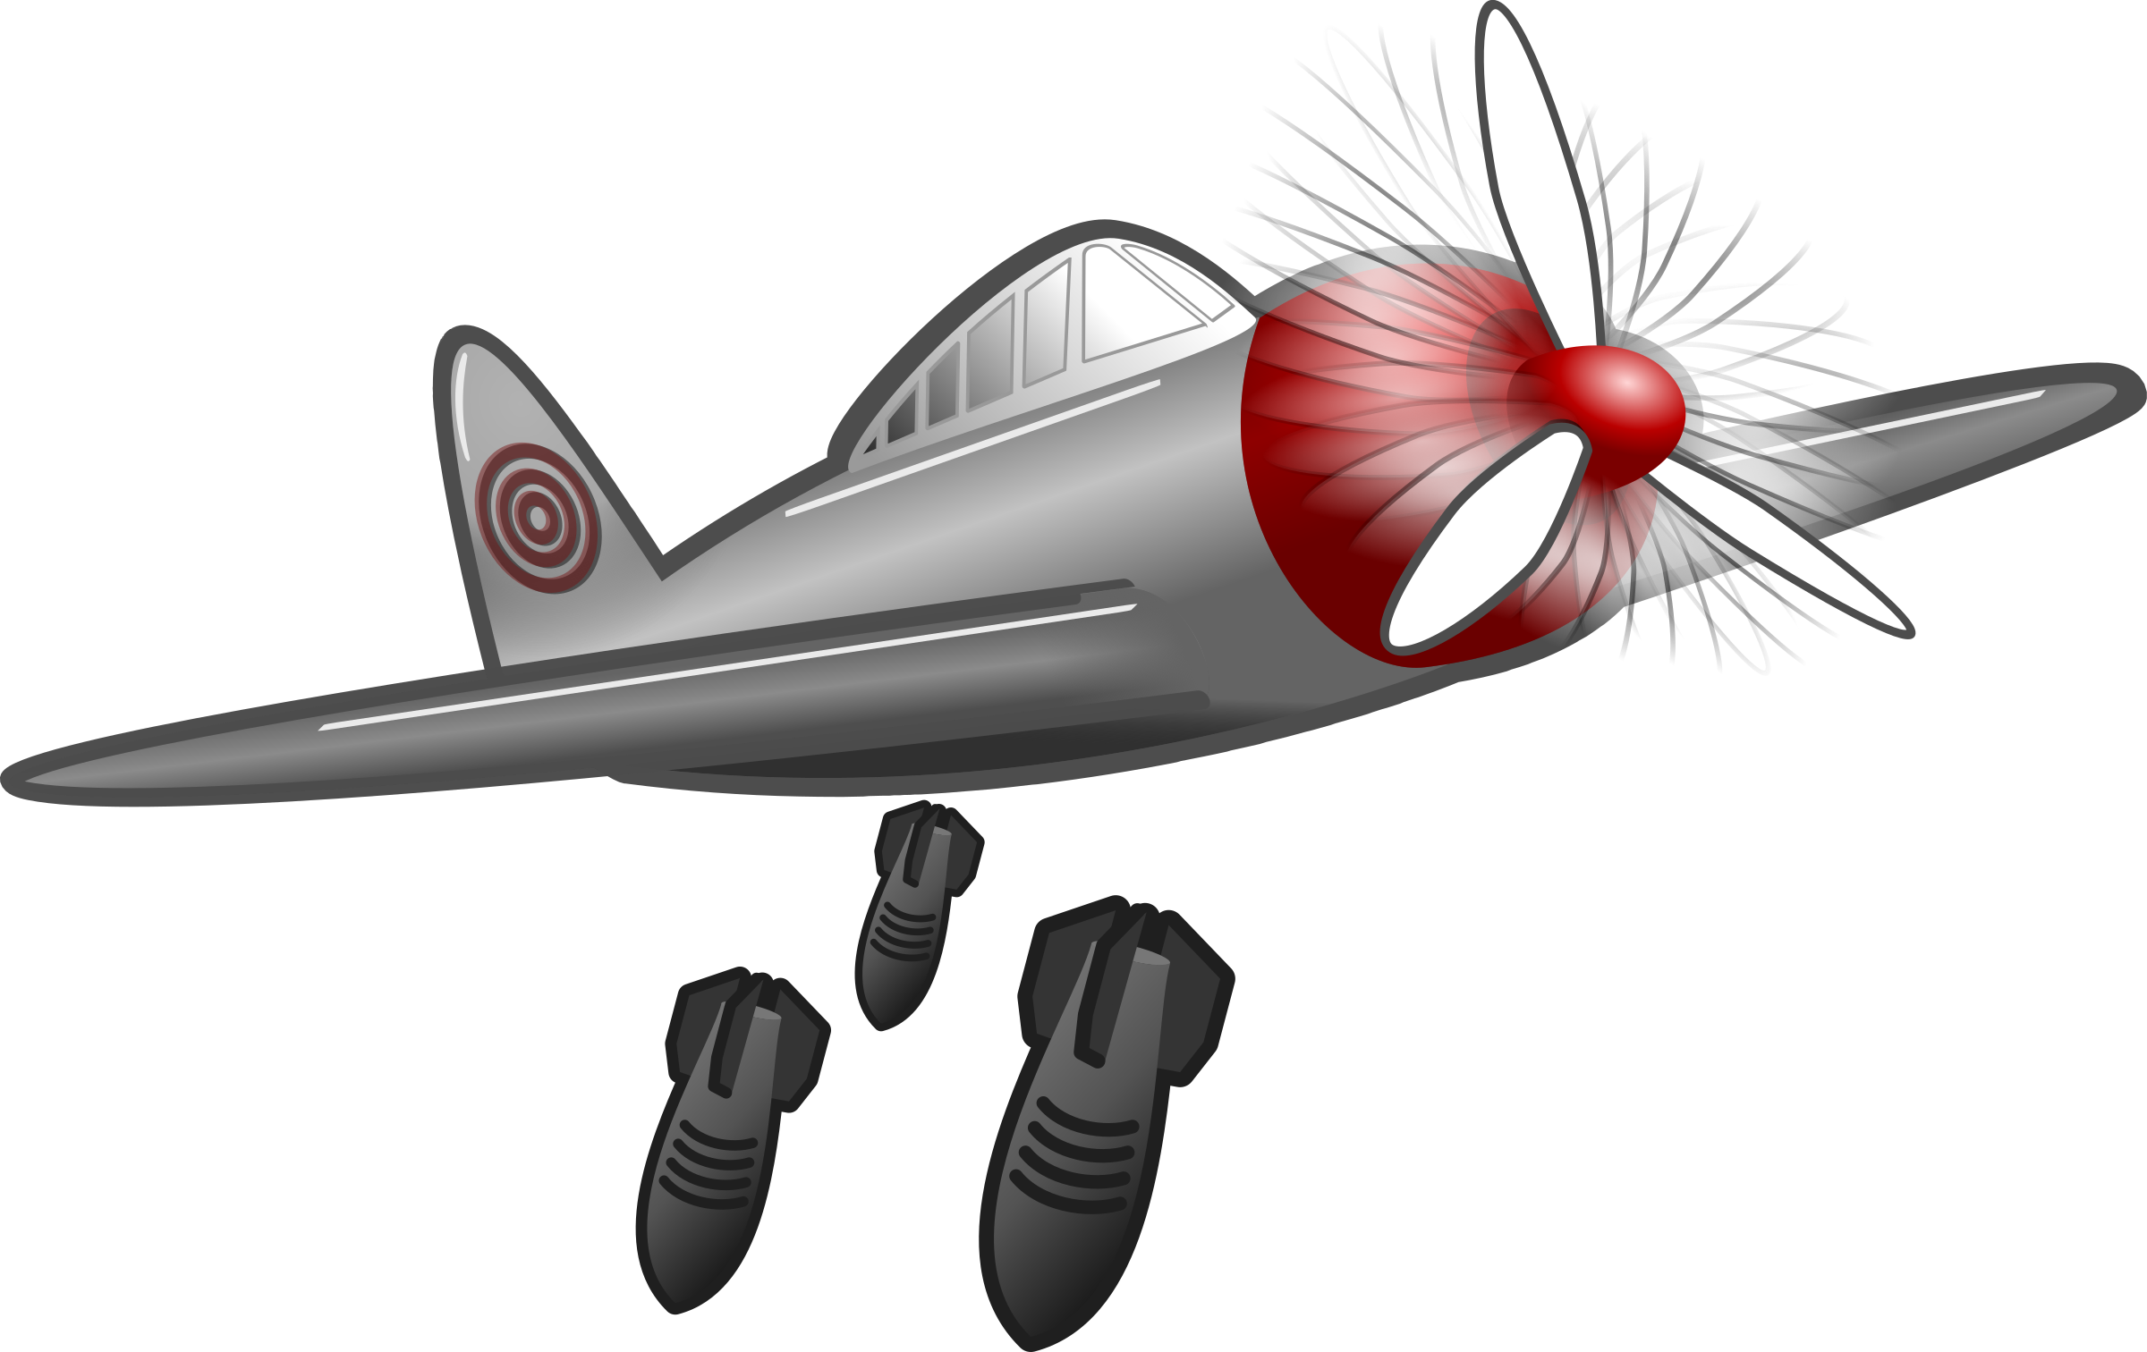
KNOWLEDGE ORGANISER
World War II
ESSENTIAL WORLD WAR II VOCABULARY
propaganda | Biased or misleading information used to promote a political cause.
allies | The 26 nations that fought against the Axis in WW2.
axis | The military alliance made up of Germany, Italy and Japan.
annex | Adding territory to one’s own territory.
discriminate | To treat a person or group of people differently.
rationing | Allowing each person to only have a fixed amount of something.
evacuee | A person evacuated from a place of danger.
evacuation | The action of moving a person or people from a place of danger.
Blitz | An intense military campaign intended to bring about a quick victory.
air raid | An attack when bombs are dropped from an air craft.
dictator | A ruler with total power over a country.
invade | Entering an area by force in order to take over.
army | An organised military force equipped for fighting.
battle | A sustained fight between large organised armed forces.
government | The group of people with the authority to govern a country or state.
September 1st 1939 | September 3rd 1939 | May 26th 1940 | July 10th 1940 | September 7th 1940 | December 7th 1941 | June 6th 1944 | May 7th 1945 | August 6th/ 9th 1945
German troops invade Poland | Britain and France declare war on Germany | Allied forces are evacuated from Dunkirk in France | The Battle of Britain begins | The Blitz begins | Japan bombs Pearl Harbour in the US | The D-Day landings | Germany surrenders to the Allies | The US drops atomic bombs on two Japanese cities
Evacuation
During the War, over 3.5 million children were sent from the cities, where it was believed they would be at less risk from bombing. They would
Key People
Winston Churchill | Adolf Hitler | Anne Frank
Winston Churchill was the Prime Minister who led Britain to victory in the Second World War. | Adolf Hitler was the leader of the Nazi Party and one of the most powerful dictators. He orchestrated WW2. | Anne Frank was a teenager who kept a diary documenting life under Nazi occupation.
only be allowed to take a small suitcase and their gas mask and would live with host families .
Rationing
As supply ships were being targeted by German bombers, food had to be conserved as much as possible. Every person was given a ration book with coupons that showed how much of each item was allowed. People were encouraged to grow as much of their own food as possible.
The Holocaust
The Holocaust is the term used for the killing of over six million Jewish people, organised by Adolf Hitler and the Nazi Party. They blamed the Jews for the problems in Germany, so they were bullied and discriminated against.
Women
Before the war, most women stayed at home and didn’t work. However, when the men were sent to war, women were needed to do jobs such as making weapons, driving transport and working in engineering.
MAKING LINKS TO PREVIOUS LEARNING GOLDEN VOCABULARY
World War 1 | The wars were started when one country invaded another.
World War 1 | The armies from each country fought each other for control.
World War 1 | In each war, the countries battled against each other.
World War 1 | The governments of each country decided whether to join the war.
Fun fact! The Battle of Britain (fought between the German Luftwaffe and the Royal Air Force) was the first ever battle to be fought only in the air.
The Blitz
The Blitz was a German bombing campaign against the United Kingdom in 1940 and 1941 during the Second World War. ‘Blitz’ is the German word for ‘lightning’ and was the term first used by the British press. It lasted for 57 nights, and the aim was to crush the British spirits so that they would surrender.
© Vocabulary Ninja Ltd 2021

